Slide 1

Fine-Tuning Models Part 5

Slide 2
What We Will Cover
Understanding Pre-Training
Understanding Fine-Tuning
When to Use Fine-Tuning
Preparing Training Data
Cost Calculations
Train / Test Split
Creating Fine-Tuning Jobs
Revisiting Hyperparameters
Analyzing the Training Metrics
Integrations
Exploring Fine-Tuning Jobs
Understanding Checkpoints
Exploring Fine-Tuning Events
Using Fine-Tuned Models
Fine-Tuning Use Cases
Continued Fine-Tuning
Practical Examples

Slide 3
Revisiting Hyperparameters AKA “Optimizers”

Slide 4
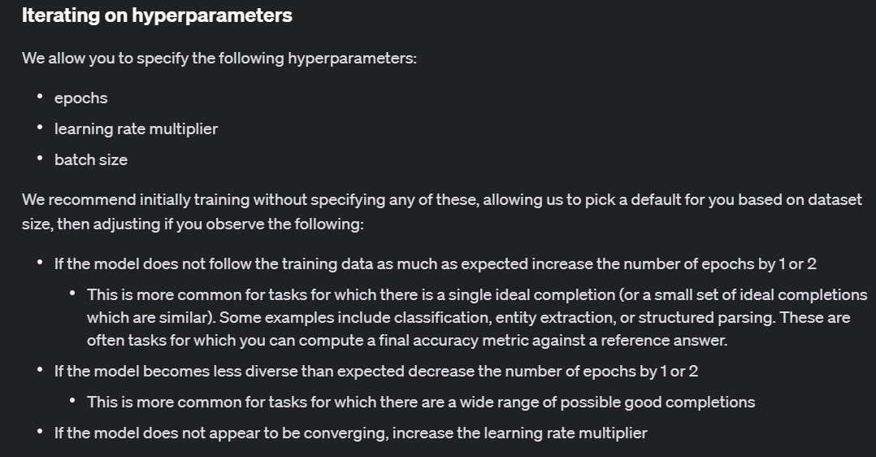
Notes:
https://platform.openai.com/docs/guides/fine-tuning/iterating-on-hyperparameters

Slide 5
Parameters vs Hyperparameters
Parameters are internal to the model and are learned from the training data.
They are the variables that the learning algorithm adjusts during the training process to minimize the error between the predicted and actual outputs.
Hyperparameters are external to the model and are set before the training process begins.
They are not learned from the training data but are used to control the learning process and influence the behavior of the model.

Slide 6
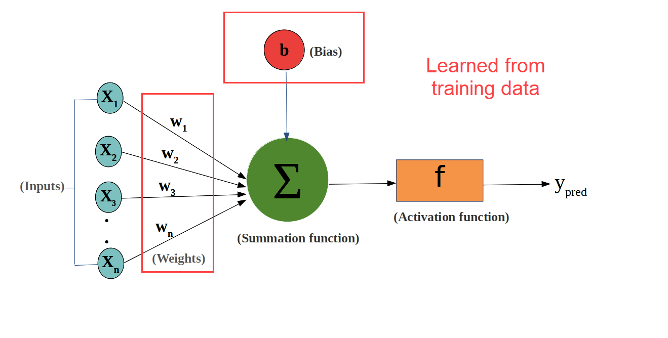
Parameters
Notes:
Weights: These are the coefficients applied to the inputs to generate the output.
Biases: These are additional constants added to the weighted sum of inputs to adjust the output.

Slide 7
Hyperparameters
Learning Rate: Determines the step size during the optimization process.
Batch Size: The number of training examples used in one iteration.
Number of Epochs: The number of times the entire training dataset is passed through the model.
Number of Layers: In neural networks, this refers to the number of hidden layers.
Number of Neurons per Layer: The number of neurons in each hidden layer.
Dropout Rate: The fraction of neurons to drop during training to prevent overfitting.

Slide 8
Hyperparameters We Can Change
Learning Rate: Determines the step size during the optimization process.
Batch Size: The number of training examples used in one iteration.
Number of Epochs: The number of times the entire training dataset is passed through the model.
Number of Layers: In neural networks, this refers to the number of hidden layers.
Number of Neurons per Layer: The number of neurons in each hidden layer.
Dropout Rate: The fraction of neurons to drop during training to prevent overfitting.

Slide 9
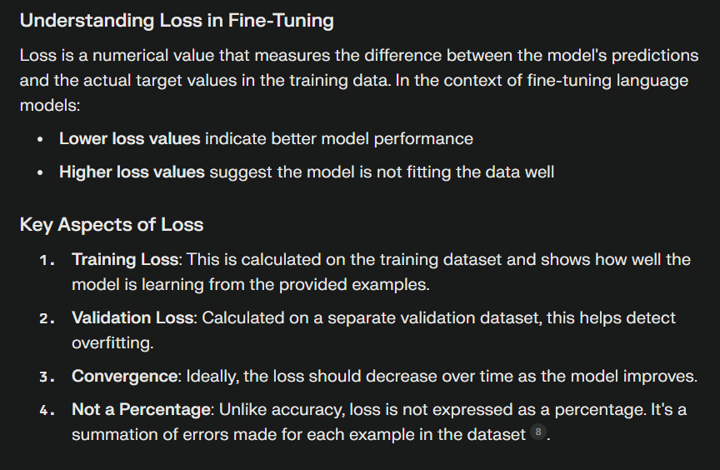
Loss Function

Slide 10
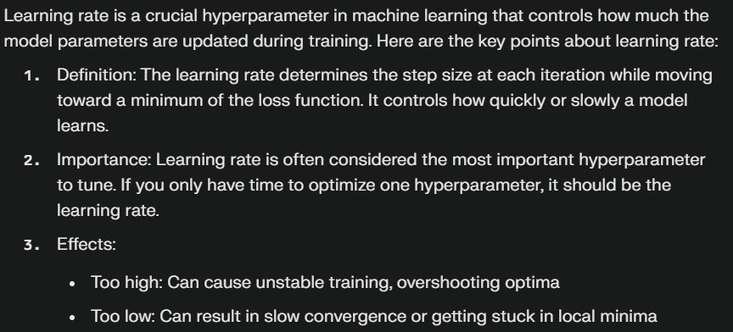
Learning Rate

Slide 11
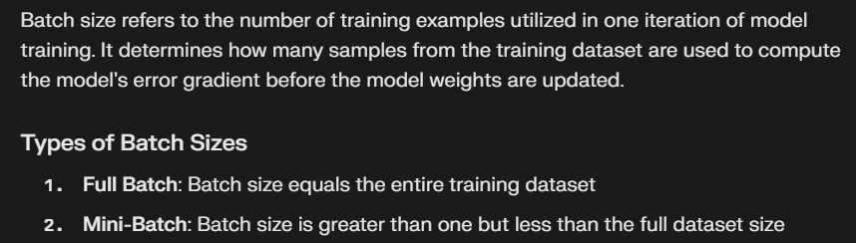
Batch Size

Slide 12
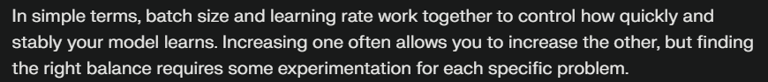
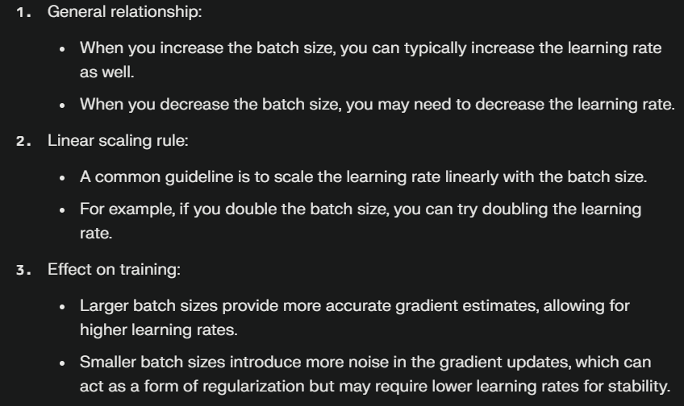
Learning Rate + Batch Size

Slide 13
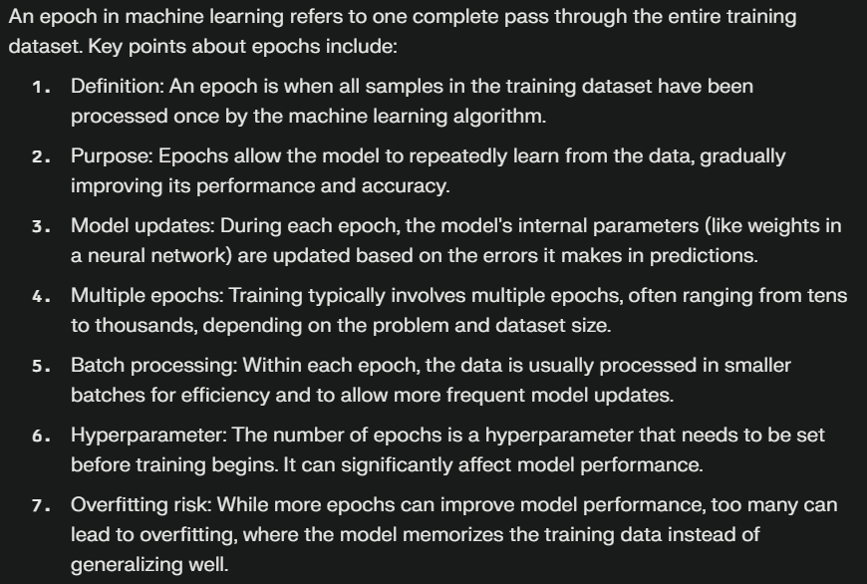
Epochs

Slide 14
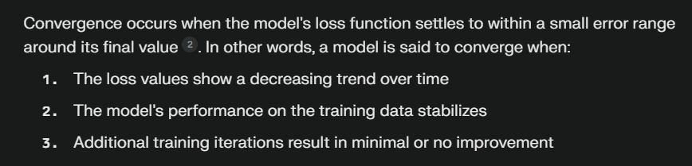
Convergence

Slide 15
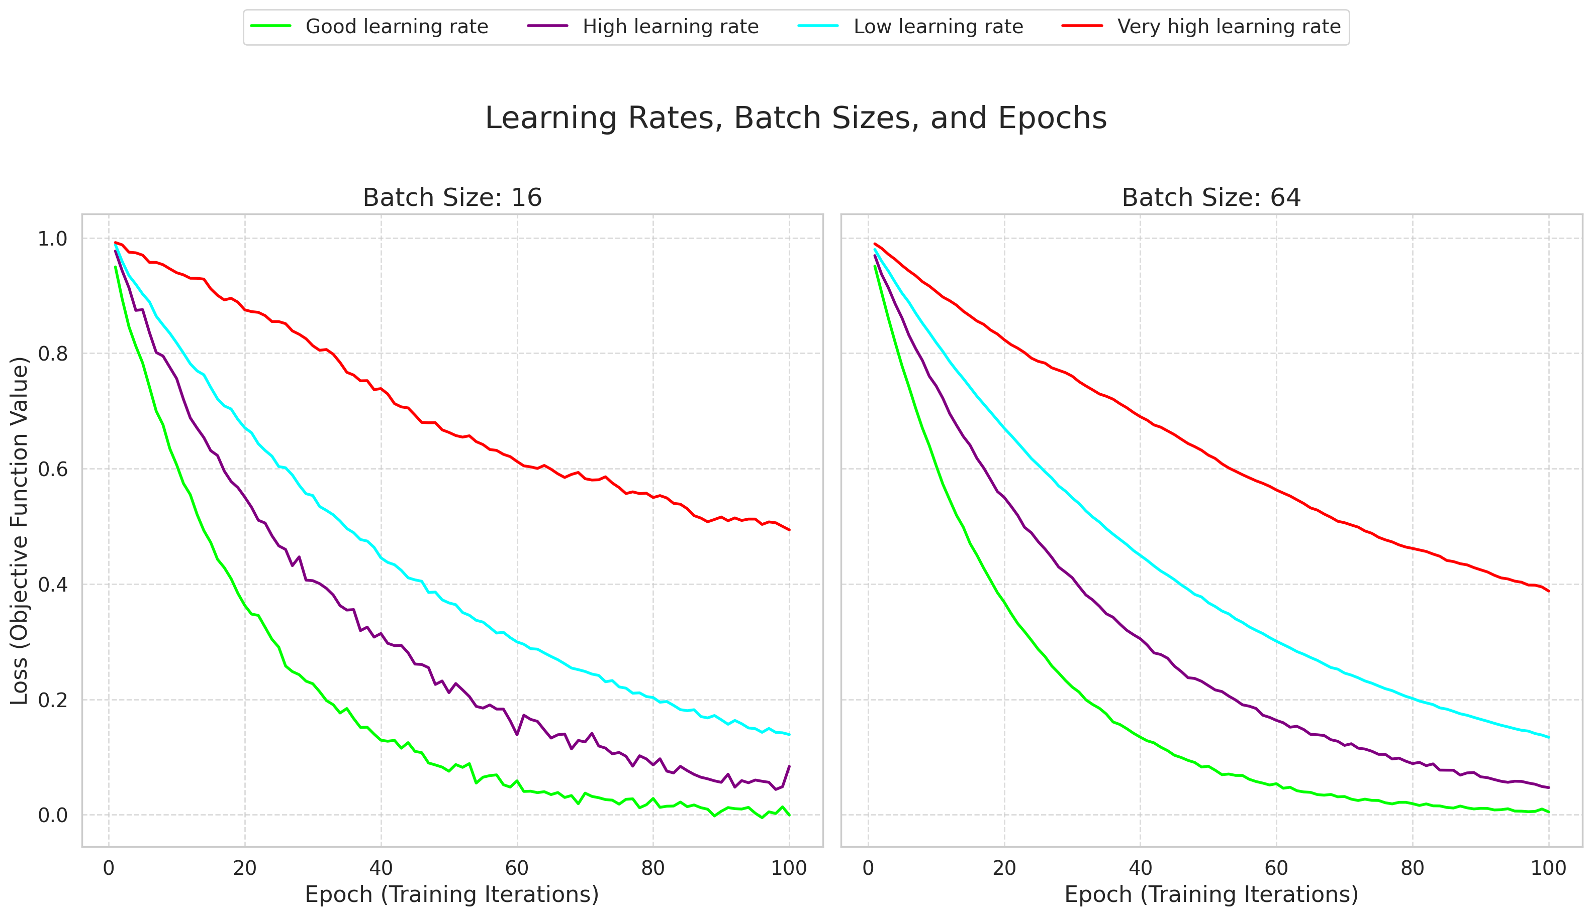
Notes:
https://towardsdatascience.com/https-medium-com-dashingaditya-rakhecha-understanding-learning-rate-dd5da26bb6de

Slide 16



Notes:
https://www.youtube.com/channel/UC35ZpwldGw7ZJ5R-2sLijzw

Slide 17
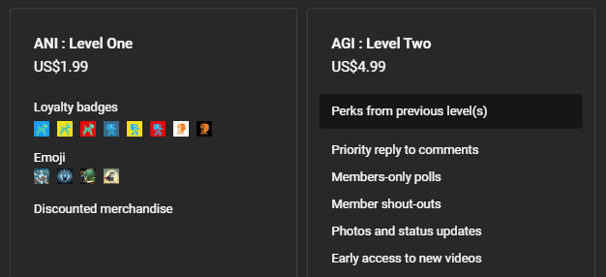
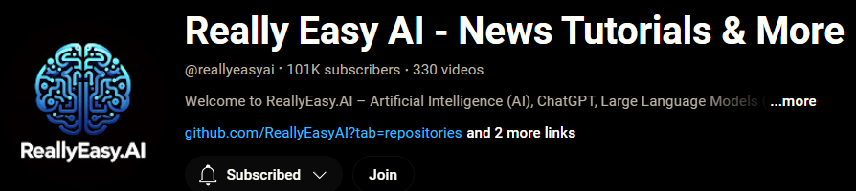
Membership has its privileges
Notes:
https://www.youtube.com/channel/UC35ZpwldGw7ZJ5R-2sLijzw/join

Slide 18

https://www.youtube.com/@AINewsFresh

Slide 19
Analyzing the Training Metrics

Slide 20
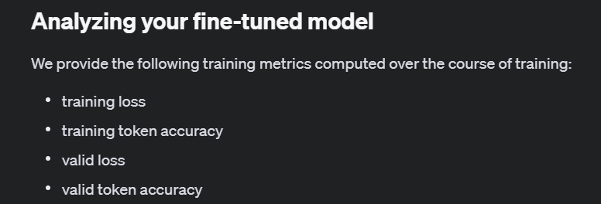
Notes:
https://platform.openai.com/docs/guides/fine-tuning/analyzing-your-fine-tuned-model

Slide 21
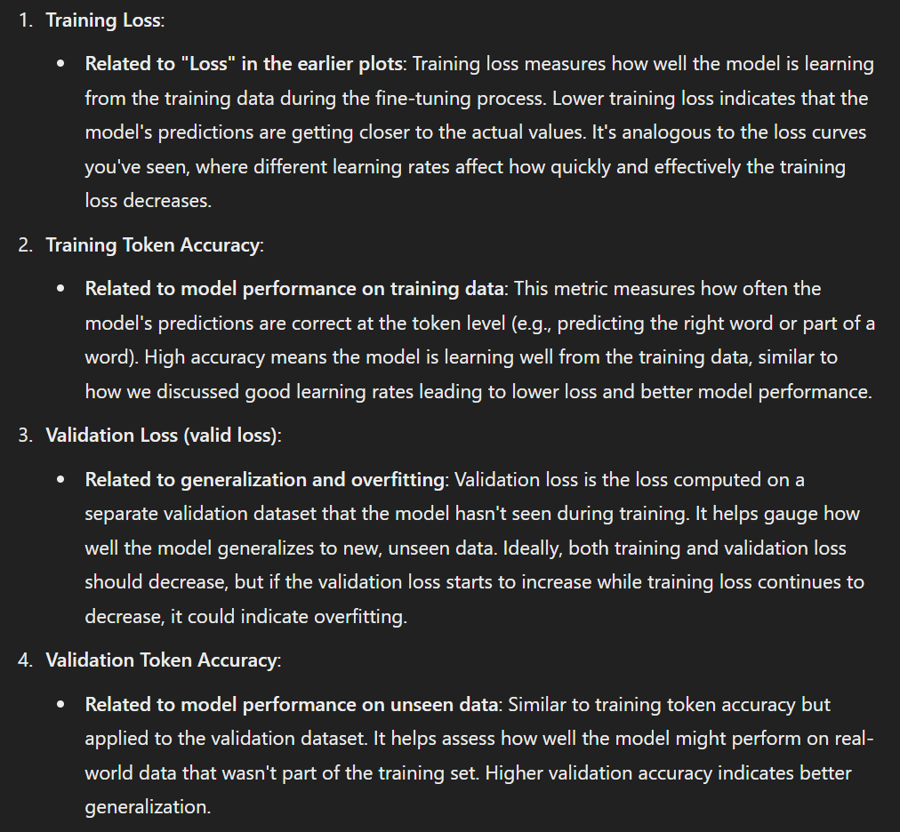

Slide 22
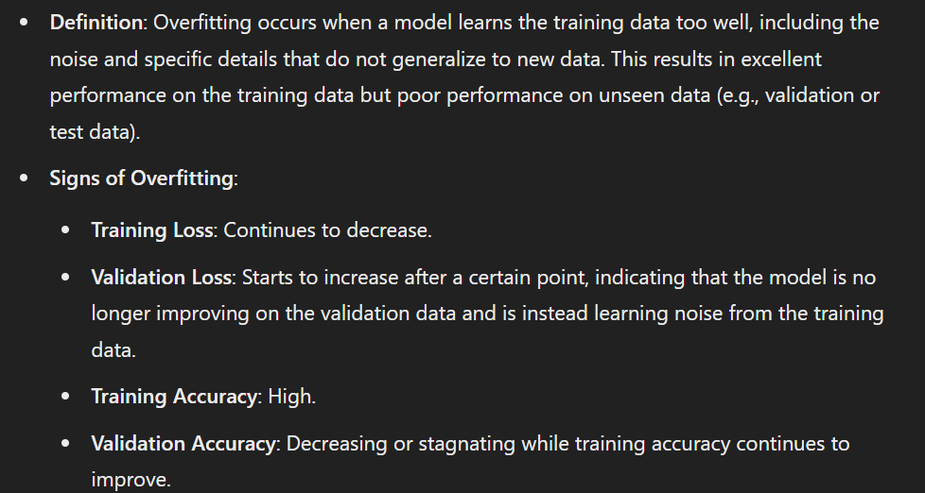
Overfitting

Slide 23
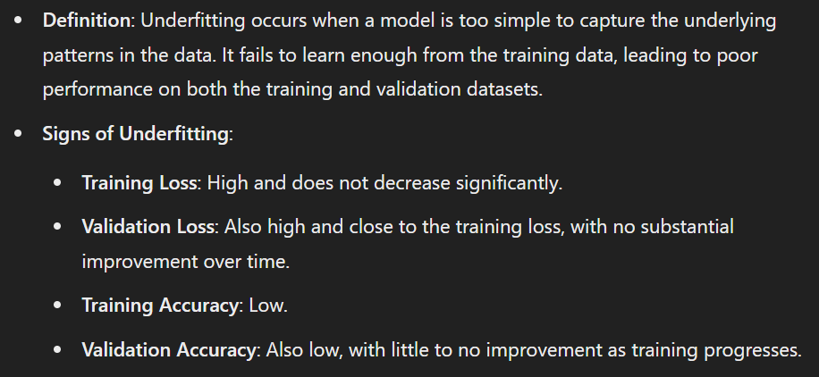
Underfitting

Slide 24
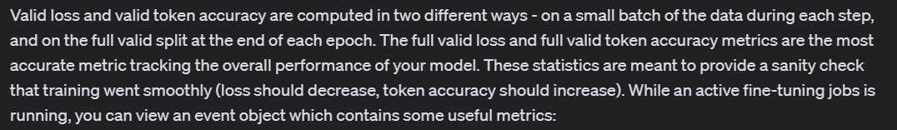
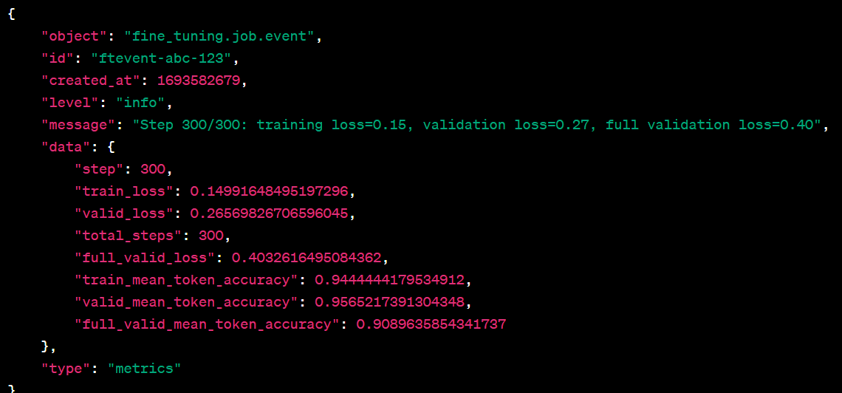

Slide 25
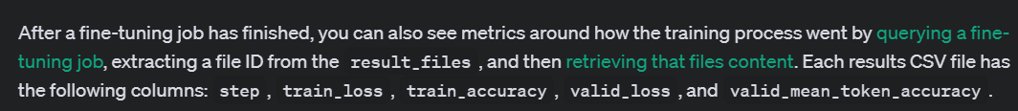
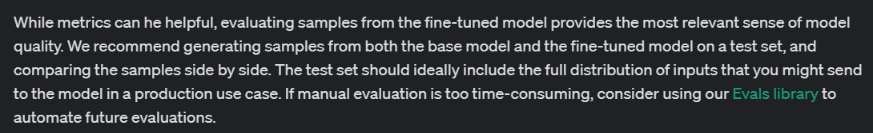

Slide 26
Demo: Pulling Training Metrics Data
def fetch_and_process_fine_tuning_metrics(client, fine_tuning_job_id):
# Function to replace colons with underscores for file names
def replace_colons_with_underscores(input_string):
return input_string.replace(':', '_')
# Get the training metrics for the fine-tuning job
fine_tune_job = client.fine_tuning.jobs.retrieve(fine_tuning_job_id)
# File ID of the file you want to download
file_id = fine_tune_job.result_files[0]
# Retrieve the file content directly
response = client.files.content(file_id)

Slide 27
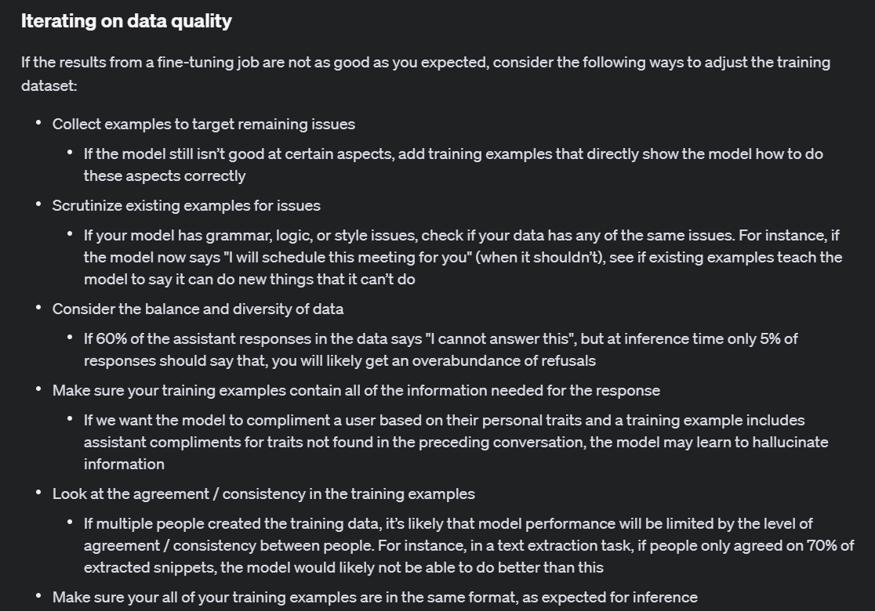
Notes:
https://platform.openai.com/docs/guides/fine-tuning/iterating-on-data-quality

Slide 28
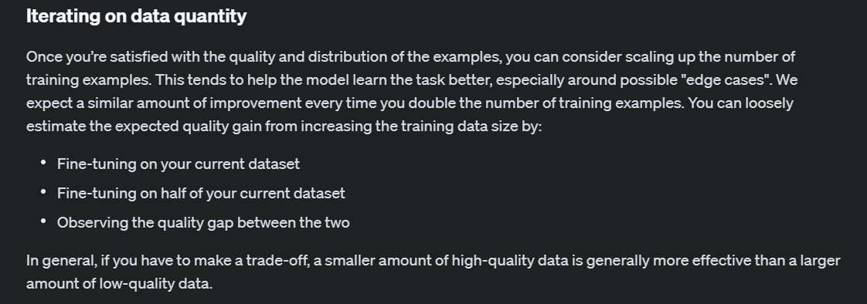
Notes:
https://platform.openai.com/docs/guides/fine-tuning/iterating-on-data-quantity

Slide 29
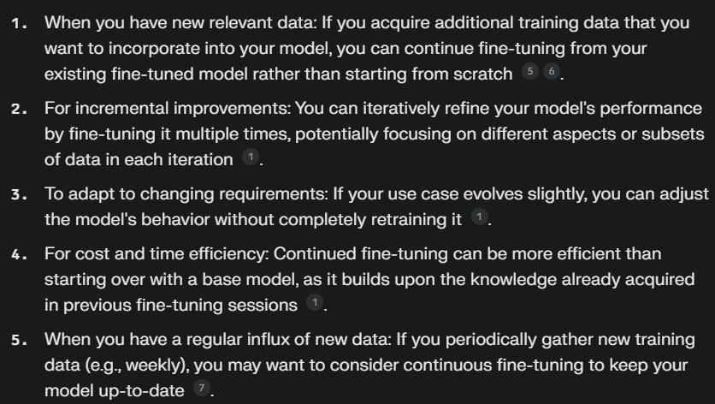
Continued Fine-Tuning “Fine-Tuning with a Fine-Tuned Model”

Slide 30
Continued Fine-Tuning Steps
Create a fine-tuning job.
Get your fine-tuned model.
Assess performance.
Create a fine-tuning job on the fine-tuned model.
Get your new fine-tuned model.
Assess performance.

Slide 31
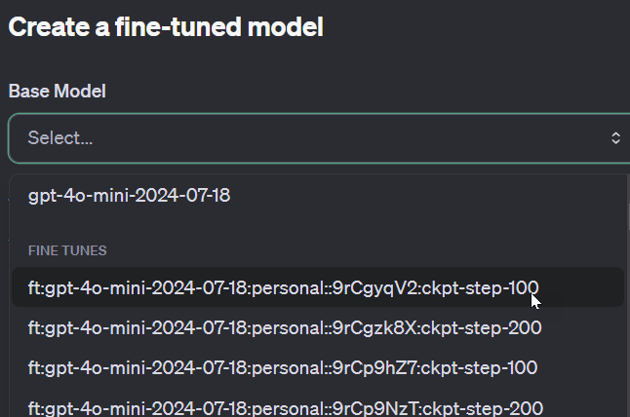
Demo: Continued Fine-Tuning (UI)

Slide 32

Integrations

Slide 33
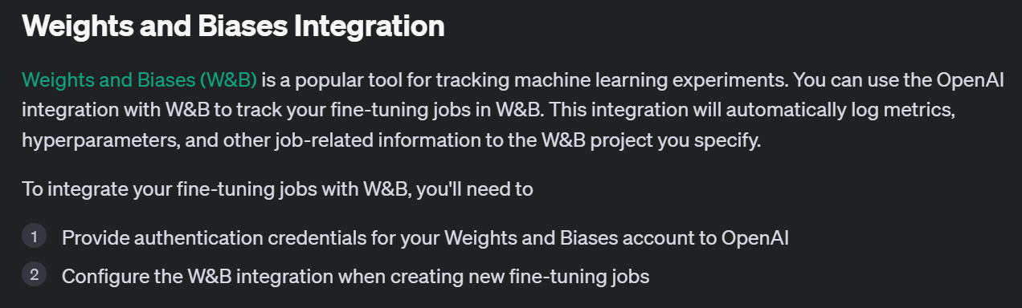
Notes:
https://platform.openai.com/docs/guides/fine-tuning/weights-and-biases-integration

Slide 34
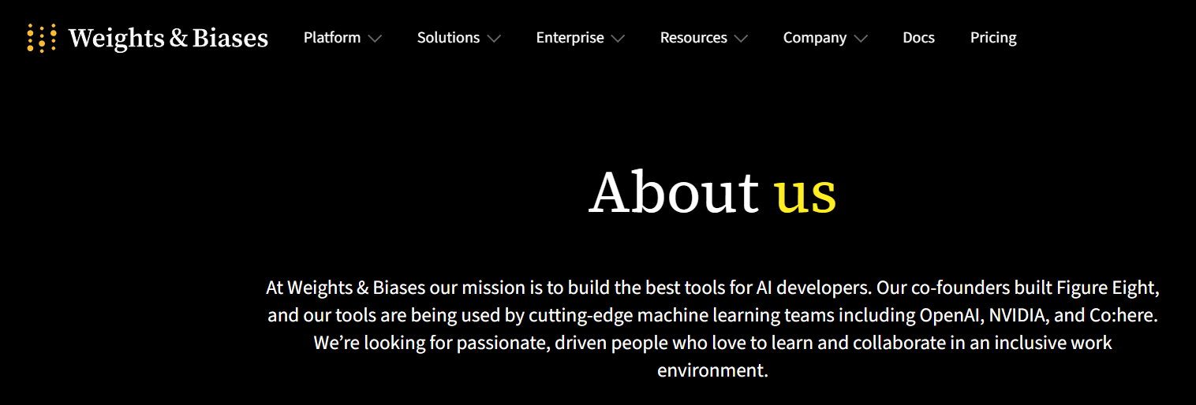
Notes:
https://wandb.ai/site/company/about-us

Slide 35
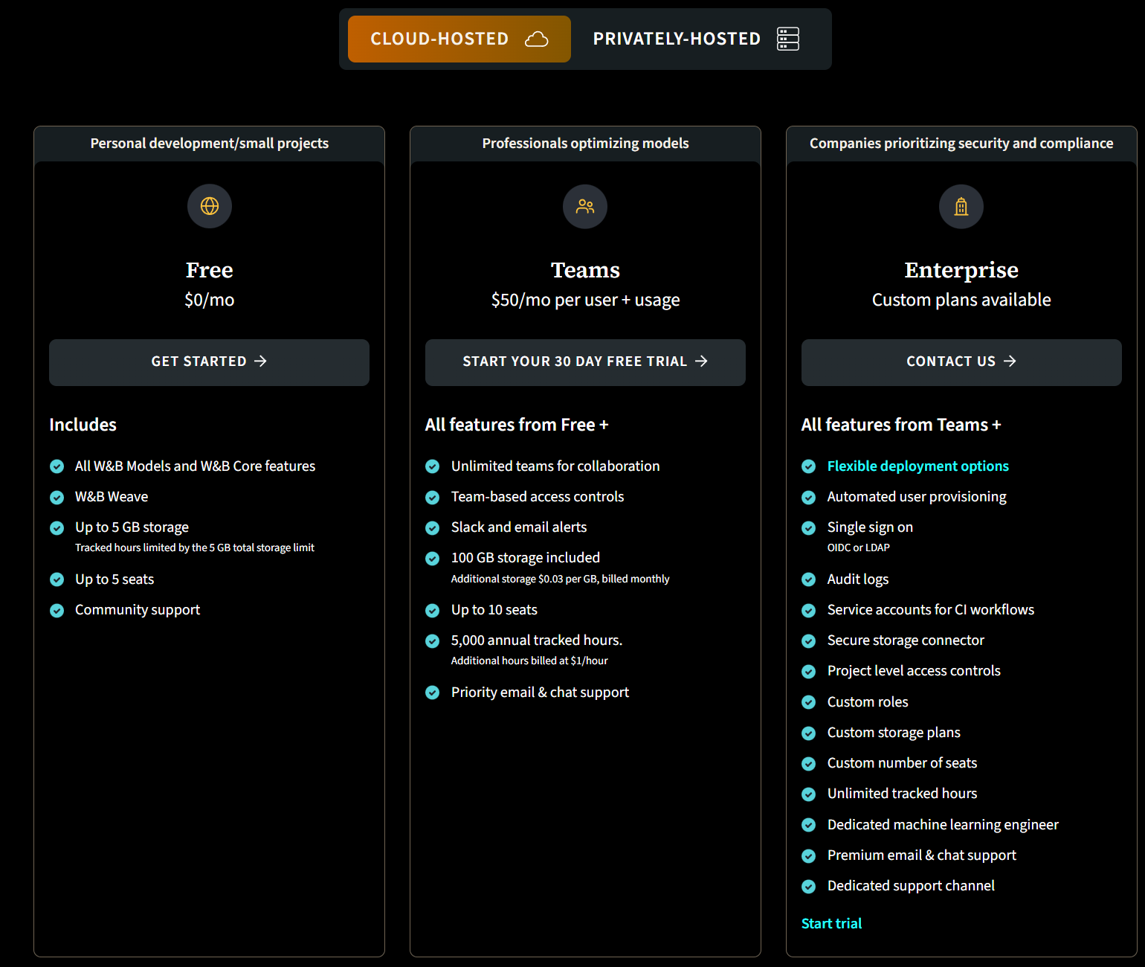
Notes:
https://wandb.ai/site/pricing

Slide 36
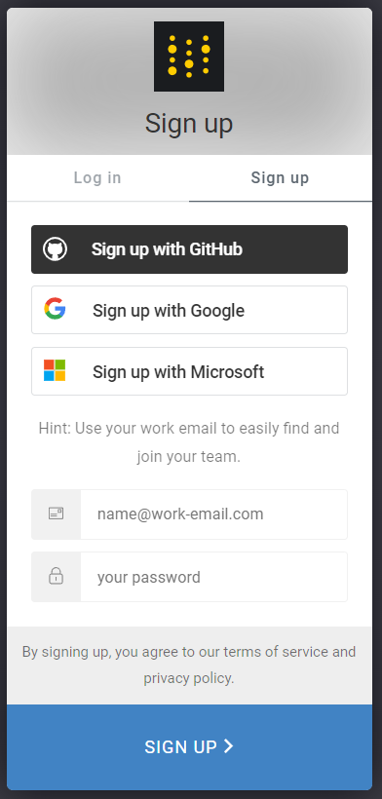
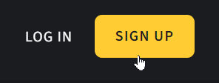
Notes:
https://wandb.ai/site

Slide 37
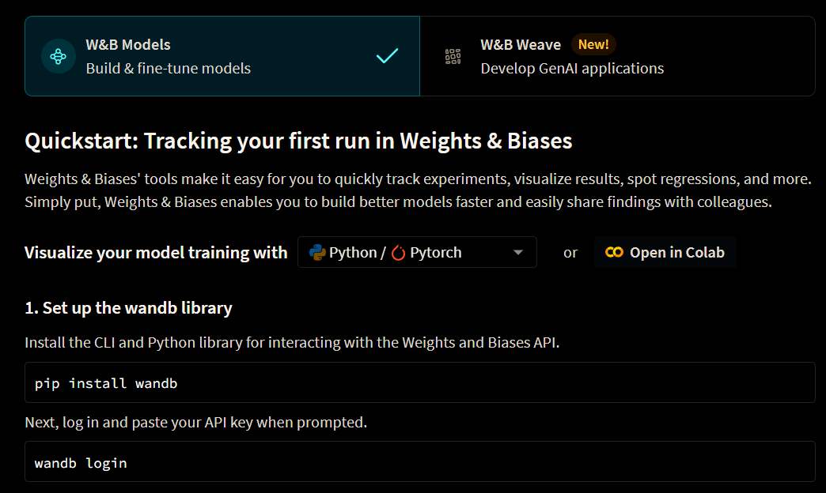
Notes:
https://wandb.ai/home

Slide 38
Demo: Weights & Biases Website
Notes:
https://wandb.ai/home

Slide 39
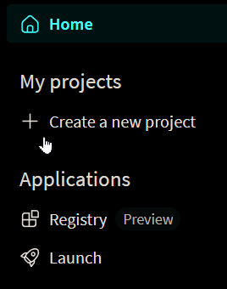
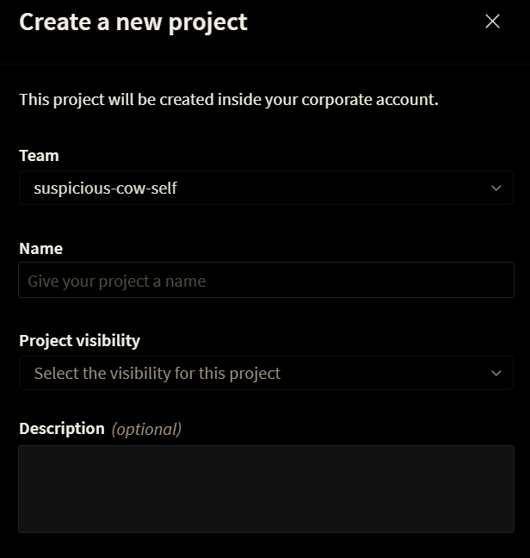

Slide 40
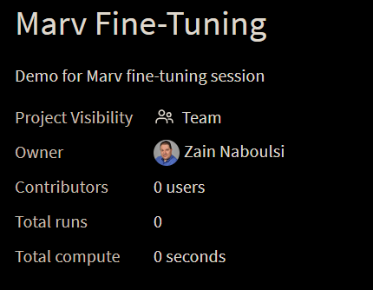
Demo: Creating a Project

Slide 41
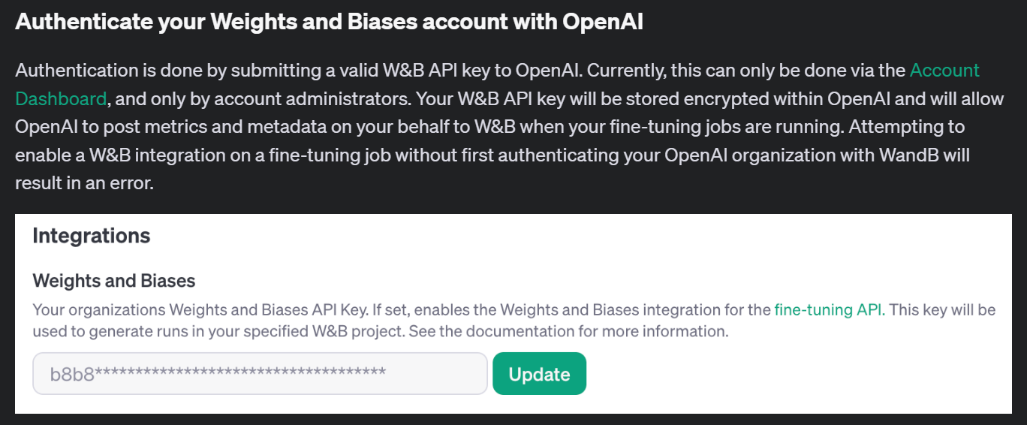
Notes:
https://platform.openai.com/docs/guides/fine-tuning/authenticate-your-weights-and-biases-account-with-openai

Slide 42
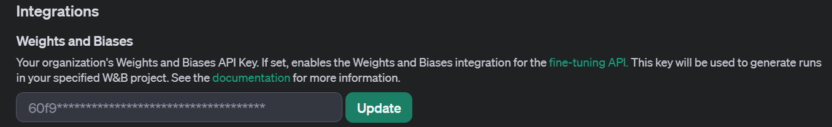
Demo: Authenticate Your W&B Account

Slide 43
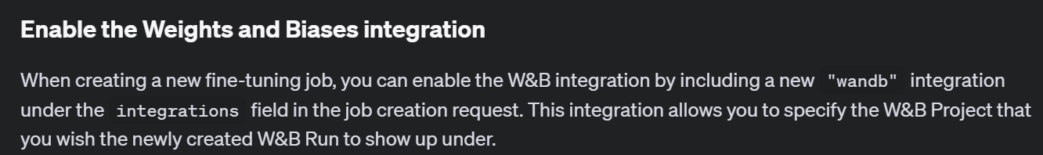
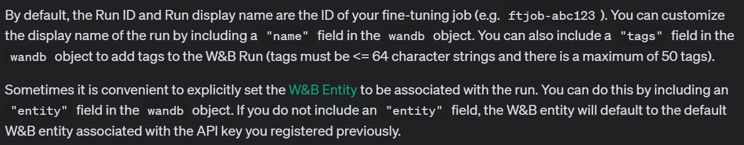
Notes:
https://platform.openai.com/docs/guides/fine-tuning/enable-the-weights-and-biases-integration

Slide 44
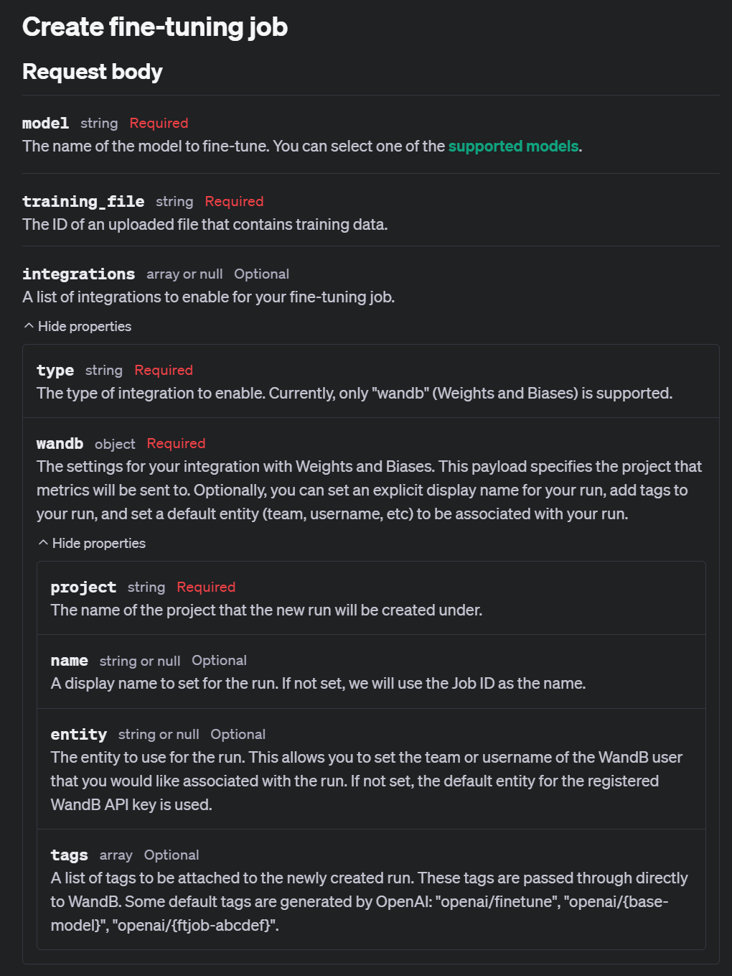
Notes:
https://platform.openai.com/docs/api-reference/fine-tuning/create

Slide 45
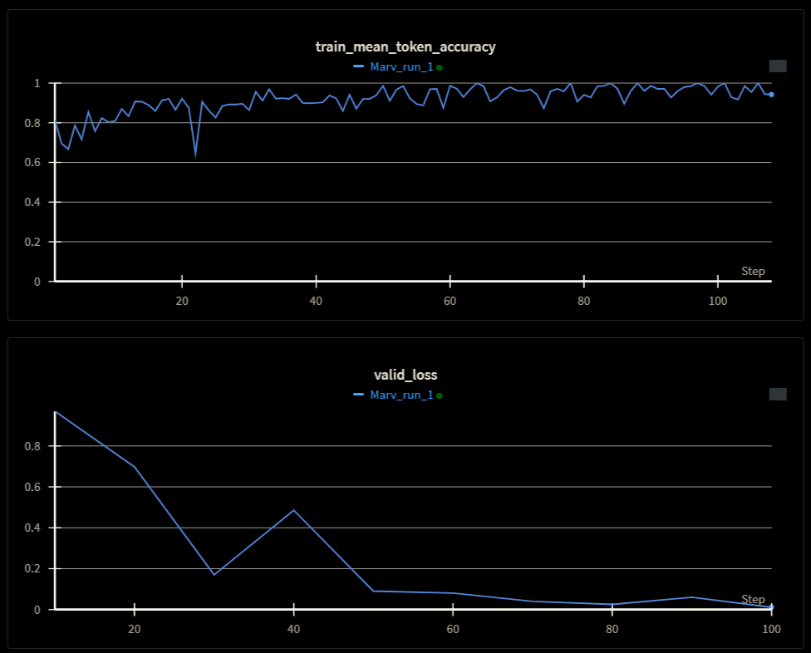
Demo: Create a Fine-Tuning Job with Integration

Slide 46
Exploring Fine-Tuning Jobs

Slide 47
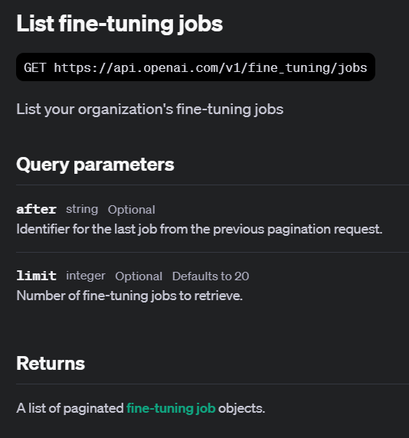
Notes:
https://platform.openai.com/docs/api-reference/fine-tuning/list

Slide 48
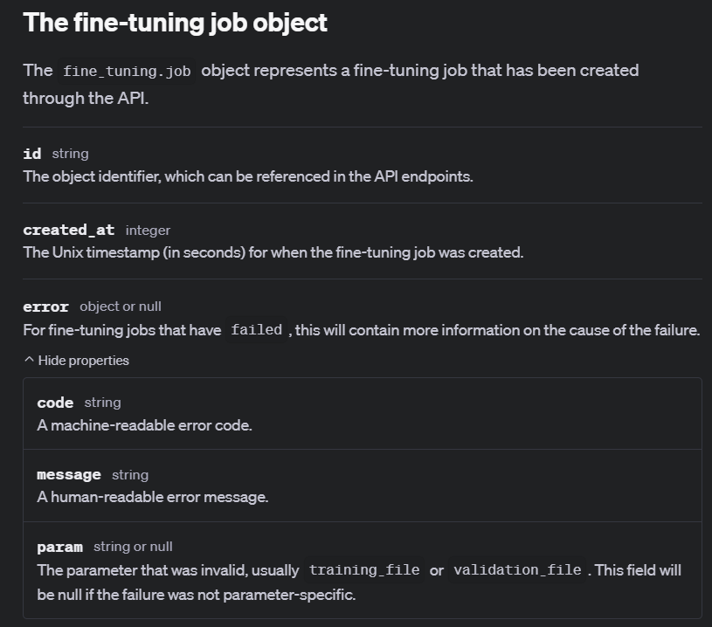
Notes:
https://platform.openai.com/docs/api-reference/fine-tuning/object

Slide 49
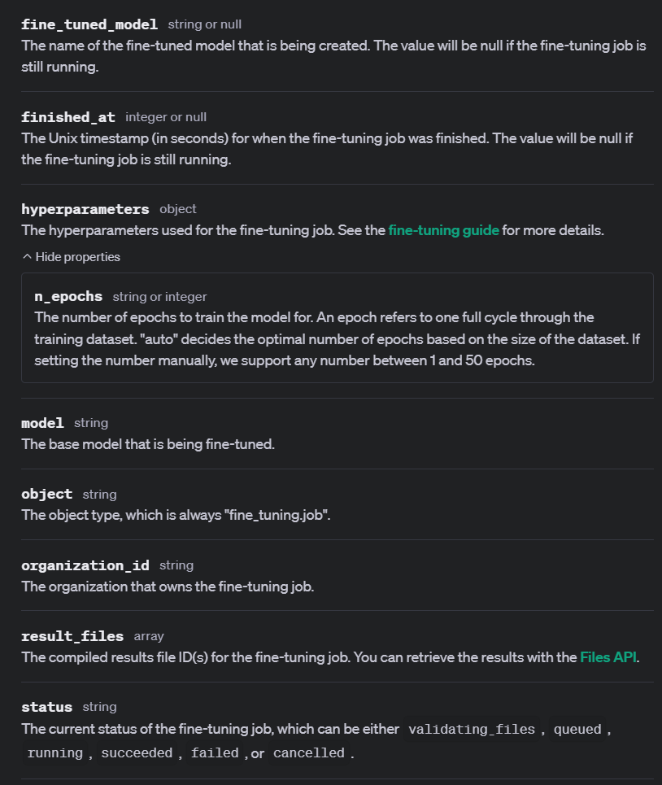
Notes:
https://platform.openai.com/docs/api-reference/fine-tuning/object

Slide 50
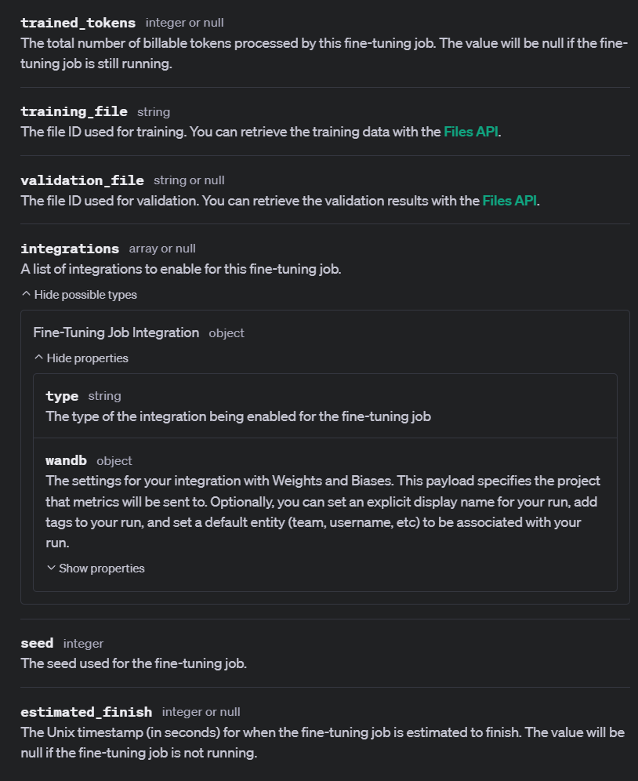

Slide 51
Demo: List Fine-Tuning Jobs
# list our fine-tuning jobs
ft_jobs_list = client.fine_tuning.jobs.list()
for job in ft_jobs_list:
print(job.id, job.object, job.status)

Slide 52
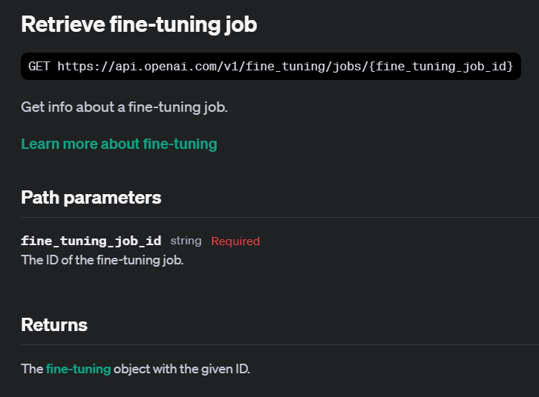
Notes:
https://platform.openai.com/docs/api-reference/fine-tuning/retrieve

Slide 53
Demo: Retrieving Fine-Tuning Jobs
# Retrieve the fine-tuning job by ID
retrieved_job = client.fine_tuning.jobs.retrieve(job.id)

Slide 54
Understanding Checkpoints

Slide 55
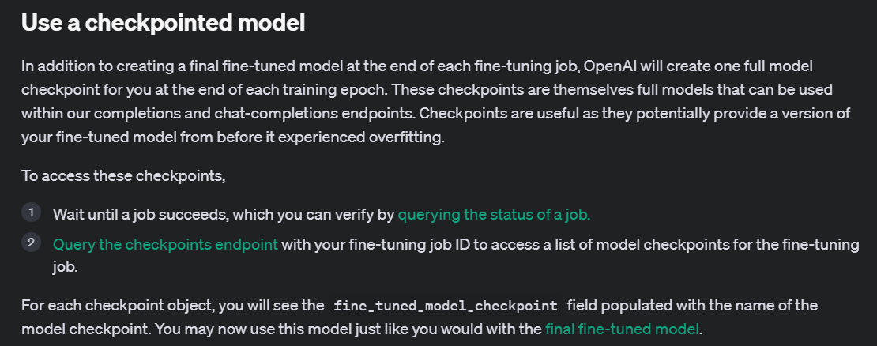
Notes:
https://platform.openai.com/docs/guides/fine-tuning/use-a-checkpointed-model

Slide 56
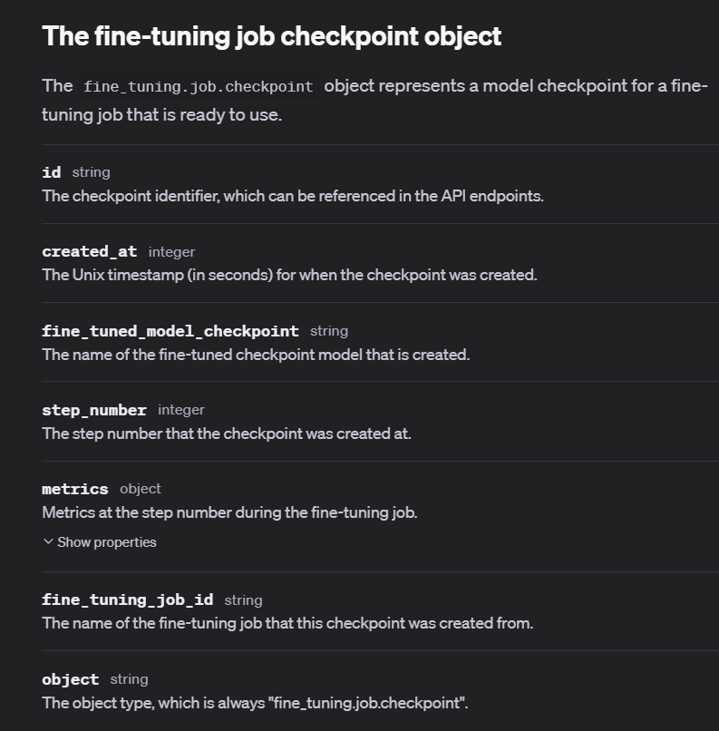
Notes:
https://platform.openai.com/docs/api-reference/fine-tuning/checkpoint-object

Slide 57
Demo: Listing Job Checkpoints
# List all fine-tuning job checkpoints
ft_jobs_checkpoints_list = client.fine_tuning.jobs.checkpoints.list(my_ft_job.id)

Slide 58
Exploring Fine-Tuning Events

Slide 59
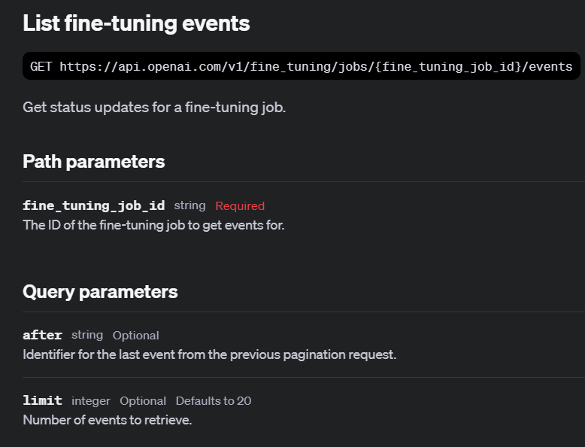
Notes:
https://platform.openai.com/docs/api-reference/fine-tuning/list-events

Slide 60
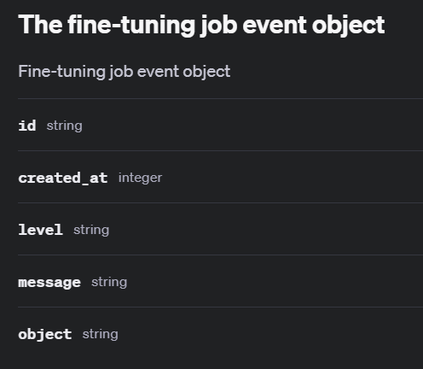
Notes:
https://platform.openai.com/docs/api-reference/fine-tuning/event-object

Slide 61
Demo: List Fine-Tuning Events
# List the events for the first fine-tuning job in our list
ft_events_list = client.fine_tuning.jobs.list_events(
fine_tuning_job_id=job.id,
limit=10
)
for event in ft_events_list.data:
print(event.id, event.object, event.created_at, event.level, event.type, event.message)

Slide 62
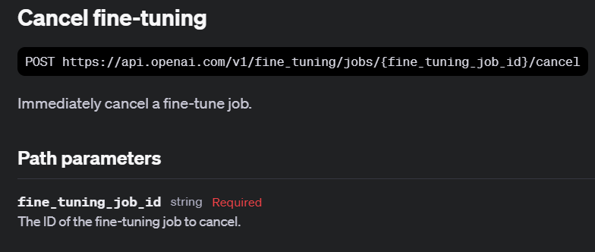
Notes:
https://platform.openai.com/docs/api-reference/fine-tuning/cancel

Slide 63
Demo: Cancelling Fine-Tuning Jobs
# Cancel the fine-tuning job
client.fine_tuning.jobs.cancel(dead_ft_job_walking.id)

Slide 64
Using Fine-Tuned Models

Slide 65
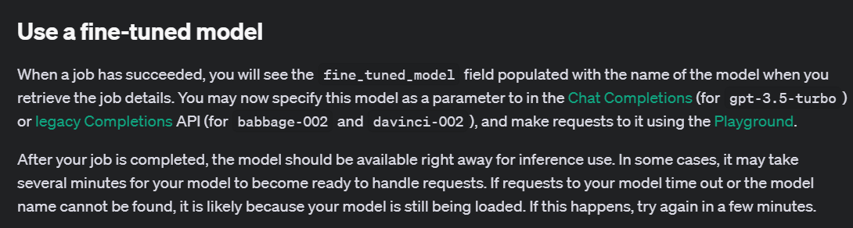
Notes:
https://platform.openai.com/docs/guides/fine-tuning/use-a-fine-tuned-model

Slide 66
Demo: Using Fine-Tuned Models
# Use the fine-tuned model to generate a completion
completion = client.chat.completions.create(
model=“ft:gpt-4o-mini-2024-07-18:personal::9rD1XNCu”,
messages=[
{"role": "system", "content": "Marv is a factual chatbot that is also sarcastic."},
{"role": "user", "content": "What is limburger cheese?"},
]
)
print(completion.choices[0].message.content)

Slide 67
Notes:
https://platform.openai.com/docs/guides/fine-tuning/use-a-checkpointed-model

Slide 68
Demo: Using Checkpointed Models
# Use the checkpointed model to generate a completion
completion = client.chat.completions.create(
model=“ft:gpt-4o-mini-2024-07-18:personal::9rD1XEpY:ckpt-step-200”,
messages=[
{"role": "system",
"content": "Marv is a factual chatbot that is also sarcastic."},
{"role": "user",
"content": "What is limburger cheese?"},
]
)

Slide 69
Fine-Tuning Use Cases

Slide 70
Style and Tone
{"messages": [
{"role": "system", "content": "Marv is a factual chatbot that is also sarcastic."},
{"role": "user", "content": "What's the capital of France?"},
{"role": "assistant", "content": "Paris, as if everyone doesn't know that already."}]}

Slide 71
Structured Output
{"messages":
[{"role": "user",
"content": "What's the weather like in Tokyo right now?"},
{"role": "assistant",
"content": null,
"function_call":
{"name": "get_current_weather",
"arguments": "{\"location\": \"Tokyo, Japan\", \"format\": \"celsius\"}"}},
{"role": "function", "name": "get_current_weather",
"content": "{\"location\": \"Tokyo, Japan\", \"temperature\": 28.5, \"unit\": \"°C\", \"humidity\": 65, \"condition\": \"partly cloudy\"}"},

Slide 72
Demo: Structured Output
response = client.chat.completions.create(
model=retrieved_job.fine_tuned_model,
messages=[
{"role": "system", "content": "You are a helpful assistant that can retrieve weather information."},
{"role": "user", "content": user_input}
],
functions=[{
"name": "get_current_weather",
"description": "Get the current weather for a specific location",
"parameters": {
"type": "object",
"properties": {
"location": {"type": "string", "description": "The city and country, e.g., 'London, UK'"},
"format": {"type": "string", "enum": ["celsius", "fahrenheit"], "description": "The temperature unit to use"}
},
"required": ["location"]
}
}],
function_call="auto"
)

Slide 73
Practical Examples

Slide 74

Notes:
https://wandb.ai/mostafaibrahim17/ml-articles/reports/Fine-Tuning-ChatGPT-for-Sentiment-Analysis-With-W-B--Vmlldzo1NjMzMjQx

Slide 75

Notes:
https://wandb.ai/mostafaibrahim17/ml-articles/reports/Crafting-Superior-Summaries-The-ChatGPT-Fine-Tuning-Guide--Vmlldzo1Njc5NDI1

Slide 76

Notes:
https://wandb.ai/mostafaibrahim17/ml-articles/reports/Fine-Tuning-ChatGPT-for-Question-Answering-With-W-B--Vmlldzo1NTEzNjU2

Slide 77

Domain Specific Fine-Tuning: Legal
Notes:
https://cookbook.openai.com/examples/third_party/gpt_finetuning_with_wandb

Slide 78

Fine Tuning a Smaller Model from a Larger Model’s Data
Notes:
https://docs.llamaindex.ai/en/stable/examples/finetuning/openai_fine_tuning/

Slide 79


